Slide 1
Communication
Chapter 4

Slide 2
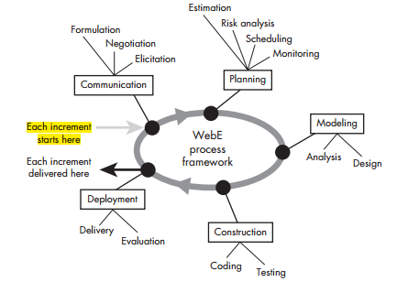
Communication
provides the WebE team with an organized way of eliciting requirements from stakeholders.
serves as the entry point for the process flow
Tasks:
ask and answer a set of fundamental questions about the WebApp and its business context (formulation)
elicit requirements that will serve as the basis for all activities that follow, and
negotiate needs against the realities of time, resources, and technology.

Slide 3
What Techniques Can You Use for Communication?
Traditional focus group
Electronic focus group
Iterative surveys
Exploratory survey
Scenario building

Slide 4
Viewpoints differences of stakeholders
business managers
feature set that will result in sales growth and improved revenue for the company
marketing group
features that will excite the potential market, leading to new customers and increased sales
product manager
a WebApp that can be built within budget and that will be ready to meet defined market windows
End users
Features that are already familiar to them and that are easy to learn and use
Web engineers
functions that are invisible to nontechnical stakeholders but that enable the infrastructure that supports more marketable features
Support engineers
the maintainability and extensibility of the WebApp

Slide 5
What Questions Should We Ask?
1. What is the main motivation (business need) for the WebApp?
2. What are the objectives that the WebApp must fulfill?
3. Who will use the WebApp?
See -> page 50 for example

Slide 6
Elicitation
is a requirements-gathering activity involving all stakeholders.
The intent is to describe the problem that the WebApp is to solve (along with basic requirements for the WebApp)
In addition, an attempt is made to identify areas of uncertainty and where potential changes will occur.

Slide 7
basic guidelines for collaborative requirements gathering
A meeting is conducted and attended by all stakeholders.
Rules for preparation and participation are established.
An agenda is suggested that is formal enough to cover all important points but informal enough to encourage the free flow of ideas.
A facilitator (can be a customer, a Web engineer, or an outsider) controls the meeting.
A definition mechanism (can be work sheets, flip charts, wall stickers, an electronic bulletin board, chat room, or virtual forum) is used

Slide 8
What Happens Before an Elicitation Session?
write a one-page WebApp description that will serve as the basis for requirements gathering.
A meeting place, time, and date are selected, and a meeting facilitator is chosen.
All stakeholders are invited to attend.
The WebApp description is distributed to all stakeholders at least 24 hours before the meeting time.

Slide 9
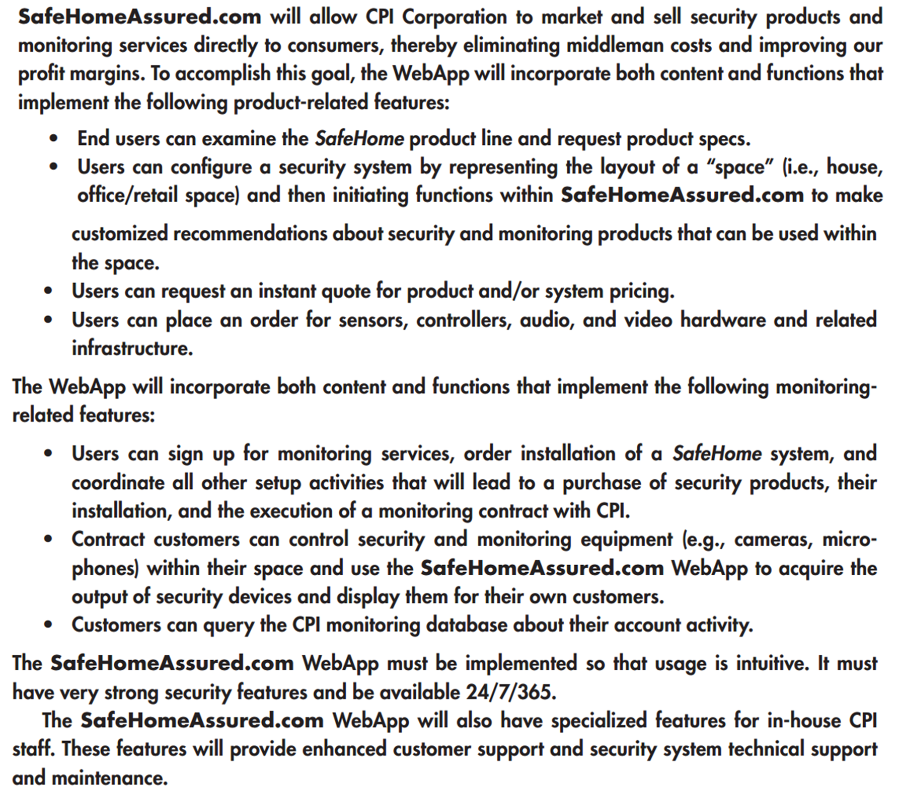

Slide 10
How Do Stakeholders Prepare?
Ask Each stakeholder to review the WebApp description before the requirements gathering meeting and make a list of “content objects”that are:
part of the environment that surrounds the system,
produced by the system, and
used by the system to perform its functions
lists are not expected to be exhaustive but are expected to reflect each person’s perception of the system

Slide 11
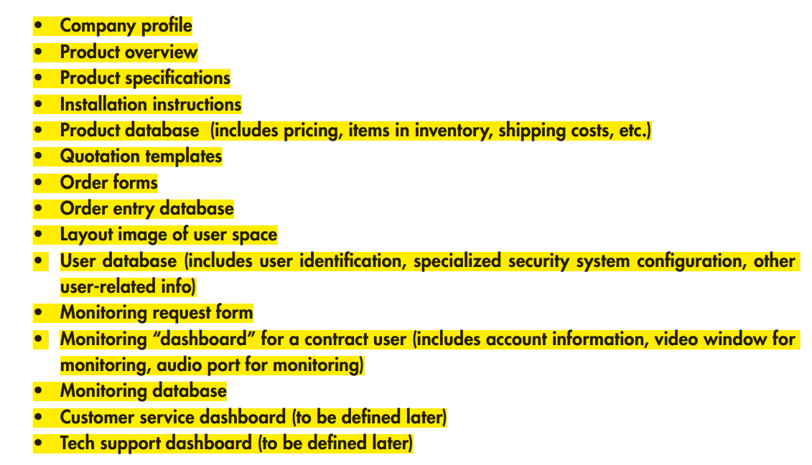

Slide 12
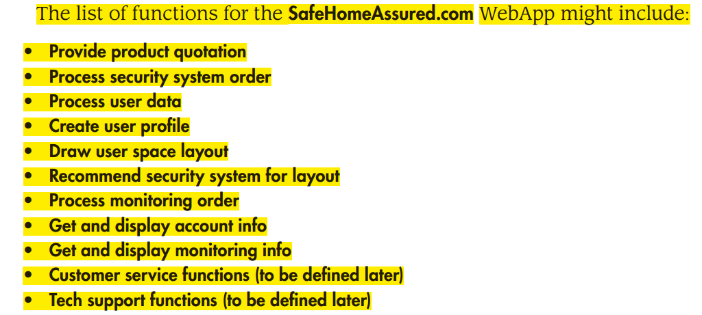

Slide 13
What Tasks Are Performed During an Elicitation Session?
first topic of discussion :
justification for the new product—everyone should agree that the product is justified
Afterward: the facilitator indicates that the group must accomplish four tasks:
Define user categories, and develop descriptions for each category.
Refine content and functionality using the lists each person prepared.
Consider specific constraints and performance issues.
Write user scenarios for each user class.
Not all of these tasks are conducted within the time span of a single requirements
gathering meeting, but all should be accomplished before the WebE process can
proceed.

Slide 14
What Are the User Categories for the WebApp?
A set of fundamental questions must be addressed to define a user category
What is the user’s overall objective when using the WebApp?
What is the user’s background and sophistication level relative to the content and functionality of the WebApp?
How will the user arrive at the WebApp?
What generic WebApp characteristics does the user like and dislike?

Slide 15
How Are Content and Functional Requirements Identified?
Review the list of content object and webApp function prepared by the stakeholders
Combine into a single list with all redundancy removed and present it in the meeting for discussion (see How Do Stakeholders Prepare?)
Allow No critique or Debate
Discuss
shorten, lengthen, or edit the list to properly reflect the WebApp to be developed
Set aside the lists are for later action.

Slide 16
How Are Constraints and Performance Issues Isolated?
Internal constraints
technical environment (in which the WebApp will reside)
specialized database protocols
the vagaries of different Web browsers
operating system characteristics, and
client-server issues
project environment (in which the WebApp will be built)
WebE tools,
development hardware,
software standards, and
Staff skill levels with various WebE technologies

Slide 17
How Are Constraints and Performance Issues Isolated?
External constraints
business and usage environment for the WebApp
Business rules,
end-user idiosyncrasies,
security demands,
privacy issues,
run-time performance,
interoperability requirements,
legal restrictions,
government regulations etc.

Slide 18
Use Cases
Use cases are a widely used approach for the creation of user scenarios. Use cases describe how a specific user category (called an actor) will interact with the WebApp to accomplish a specific action
benefits:
Use cases provide the detail necessary for effective planning and modeling activities.
Use cases help the developer to understand how users perceive their interaction with the WebApp.
Use cases help to compartmentalize Web engineering work because they can be organized into WebApp increments.
Use cases provide important guidance for those who must test the WebApp

Slide 19
